Slide 1

CAR RENTALS

Slide 2

PROBLEMS
WE ARE SOLVING CAR OWNER PROBLEM LIKE IF YOUR CAR IS IDLE AT HOME THEN YOU CAN EARN MONEY BY RENTING YOUR VEHICLE

Slide 3
TOOLS
PYTHON
SQL

Slide 4
Road PLAN
DATABASE
(OWNERS , CUSTOMERS)
- HARSHA
- NARAYANA
FRONTEND FOR OWNER
KUNDAN
FRONTEND FOR CUSTOMER
- MANAN
LOADING THE DATA
- SURESH

Slide 5
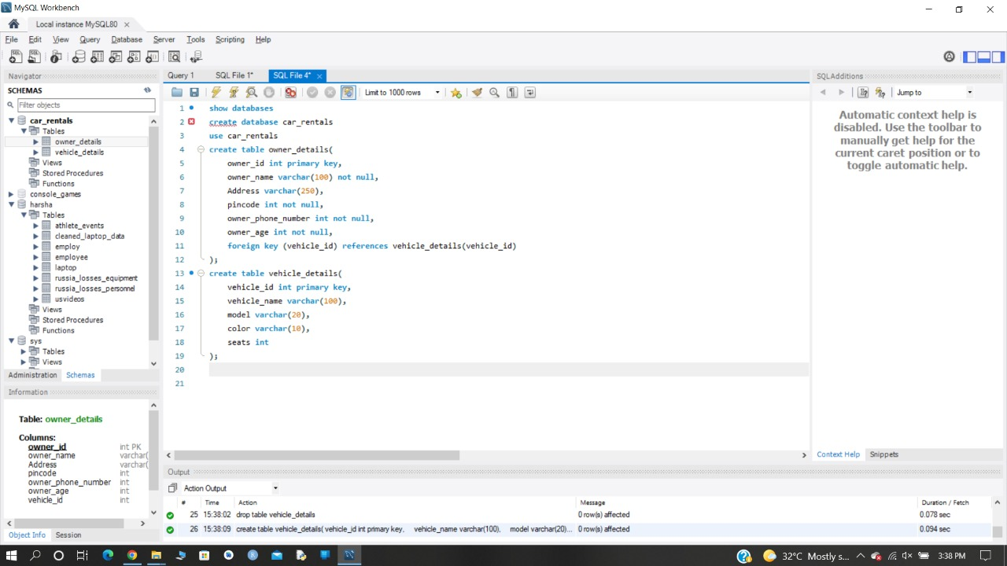

Slide 6
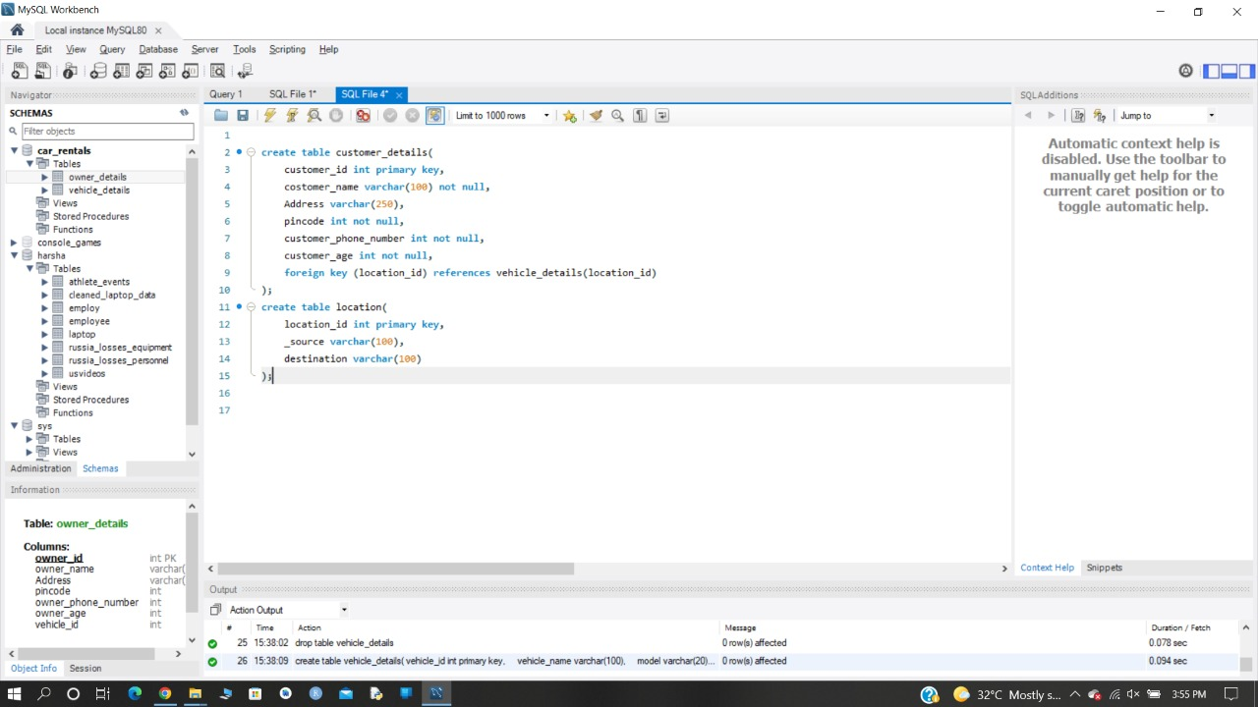

Slide 7
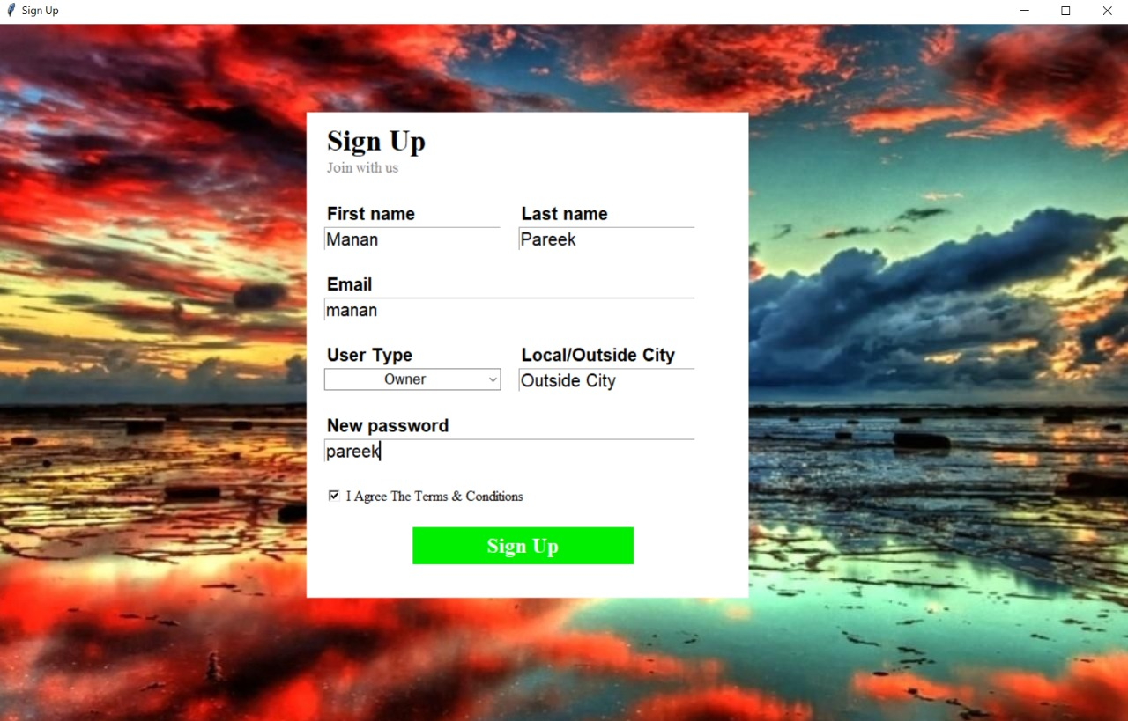

Slide 8
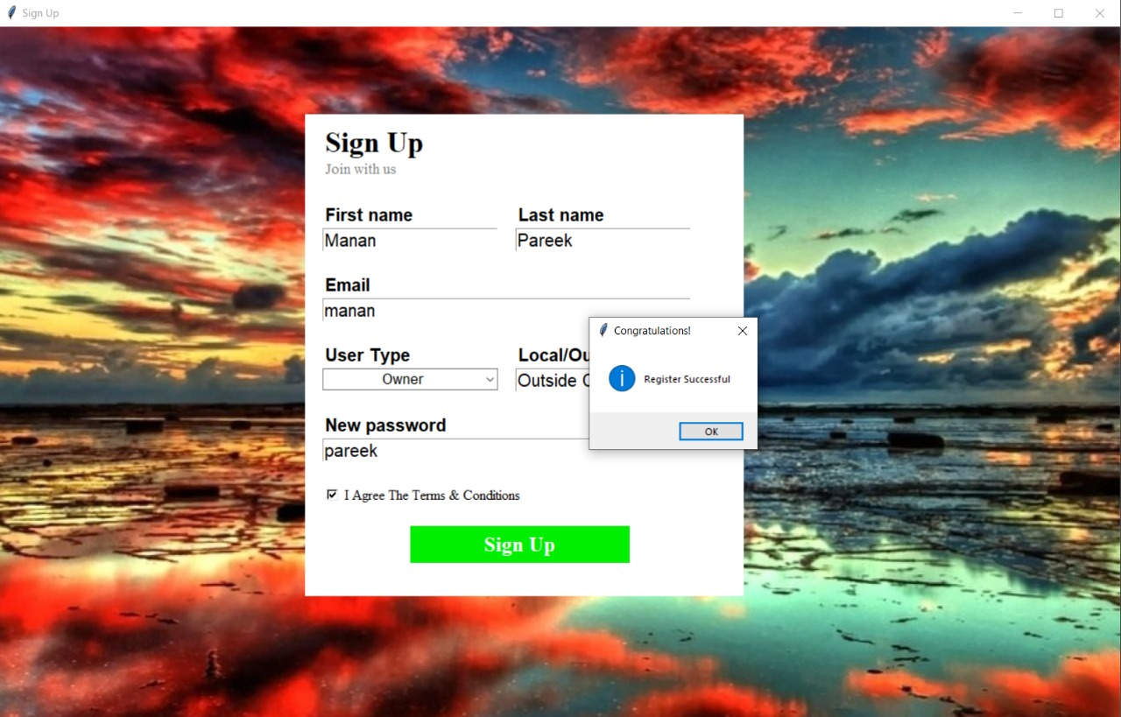

Slide 9
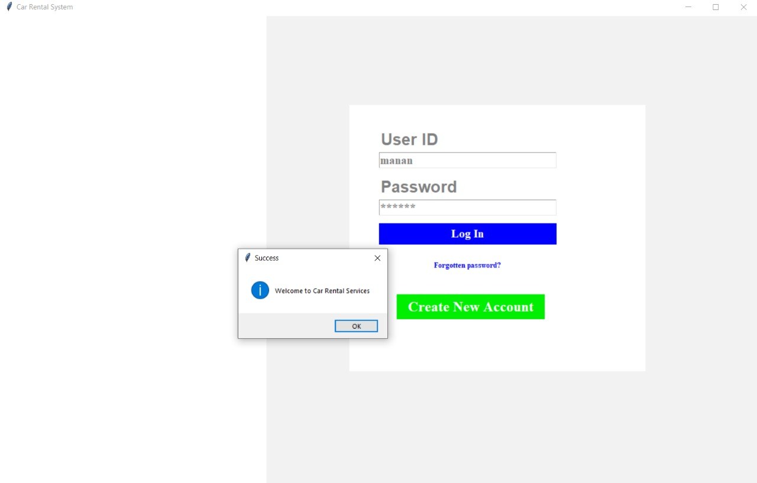

Slide 10
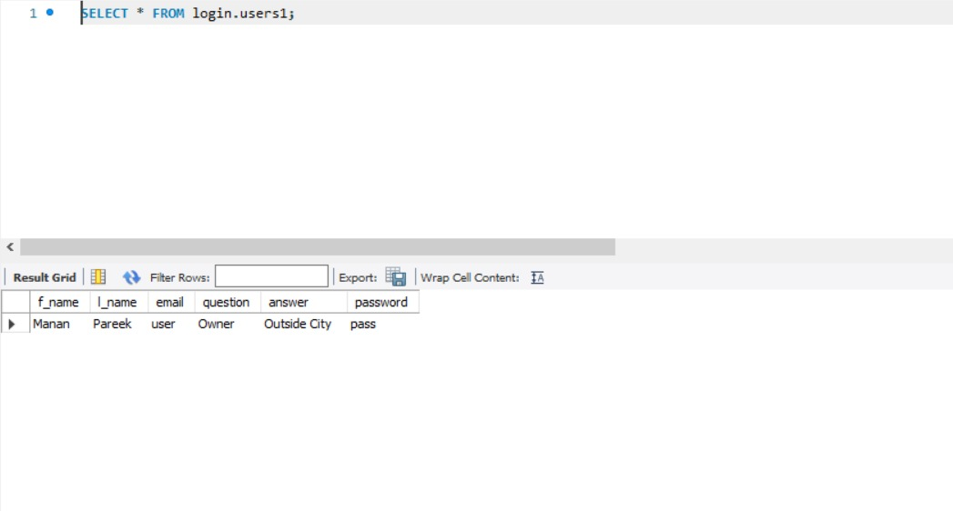

Slide 11
END
the great

